Slide 1

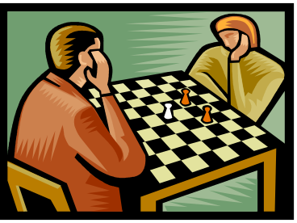
TWO KNIGHTS SWISS
Chess Tournament
November 27, 2010
Fayetteville, NC
9:00 a.m. 1st Round
(Registration 8 – 9:00a.m.)
Three Rounds – Game 75
$20.00 Entry Fee
Christ United Methodist Church
3101 Raeford Road
Fayetteville, NC
(Across the street from Tallywood Shopping Center.)
(Entry on right side of building.)
Adam Rugg and Gary Morris TD’s
(910-484-7355 910-635-4482)
Email: g.l.morris@att.net

